Slide 1
PROJ 216 Software Project Concepts
Day 5

Slide 2
Topics
Object-Oriented Programming Concepts
UML Class Diagram
Three-Layer Application Structure
UML Package Diagram
Project Closing

Slide 3
Object-Oriented Programming Concepts
Classes and Objects
Interface versus Implementation
Encapsulation and Data Hiding
Class Relationships
Association
Aggregation (Composition)
Generalization (Inheritance)

Slide 4
Classes and Objects
A class is a program code template for creating objects
Specifies data that each object of the class has (member variables) and implementations of behaviour (member methods)
A class is used to create objects
Each object create from a class is called an instance of the class
https://www.developer.com/java/other/article.php/3347291/Thinking-in-Objects.htm

Slide 5
Interface and Implementation
Interface is a set of functions of an object that are exposed to the outside world
Just a list of functions (methods) and how to use them
Public members define the interface
Implementation is the actual implementation of the object’s behaviour
Detailed code of the methods
Internal data
Private members define the implementation

Slide 6
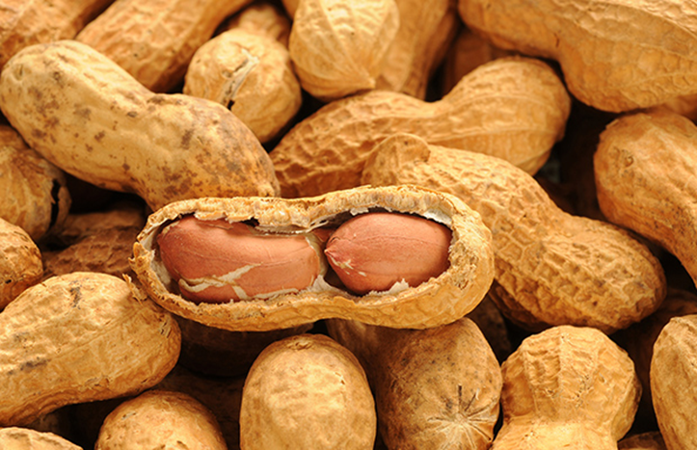
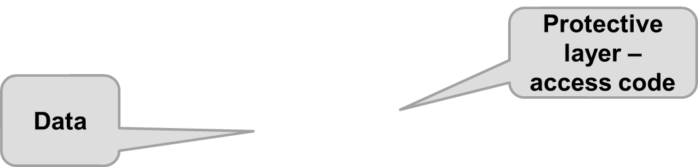
Encapsulation and Data Hiding
Encapsulation – combining data and operations into a single unit
Data Hiding – hiding the details of internal data members of an object

Slide 7
Identifying Entity Classes
Get a written problem statement
Identify the nouns or noun phrases
These might indicate classes or attributes of classes
Is it well-defined and relevant to the problem domain?
It is likely an attribute
When it is a single value
Describes a characteristic of something else
It is likely a class when
It can exist independently
Has more complex structure or behaviour
Has relationships to other concepts

Slide 8
Group Exercise – 20 minutes
Temporary Employment Agency (TEA) problem description is provided in a separate document
List nouns/ noun phrases
Identify classes and attributes

Slide 9
Association Relationship
System’s behaviour is accomplished by collaboration of objects
Objects collaborate by calling methods, passing parameters, and receiving returned values
An association between classes means that an object of one class invokes public member of another class object
Example: Student enrolls in a Course
More examples of association between classes?
Majority of relationships between classes are associations

Slide 10
Special Relationships between classes
Aggregation (Composition) – one class object is part of another class object
“Is a part of”, “has a”
For example, a Scrollbar is a part of a Window (a Window has a Scrollbar)
Generalization (Inheritance) – one class is a special case of another class
“Is a special case of “, “is a”
For example, PartTimeEmployee is a special case of an Employee
Give examples of aggregation or generalization relationships

Slide 11
Identify type of Realationship
An Employee works on a Project
An Employee belongs to a Department
A Deck is made of Cards
A Form has various Controls on it
A Form Control can be a Button, or a Text Box, or something else

Slide 12
UML Class Diagram
Classes
Attributes
Operations
Relationships:
Association
Name, role names
Multiplicities
Aggregation
Generalization
https://www.visual-paradigm.com/guide/uml-unified-modeling-language/uml-class-diagram-tutorial/
MS Visio Demo

Slide 13
Multiplicity of an Association
How many objects of the class participate in a relationship?
One-to-one: SaleTransaction to CreditCardPayment
One-to-many: SaleTransaction to ProductSold
Many-to-many: Customer to Salesperson
Multiplicities at the end of an association:
0..* or * zero or more
1.. * one or more
N concrete number
1..1 or 1 exactly one
0..1 zero or one

Slide 14
Exercise
What are the multiplicities at each end of the following relationships:
A patient must be assigned to only one doctor, and a doctor can have many patients
An employee has one phone extension, and a unique phone extension is assigned to each employee
A movie theatre show many different movies, and the same movie can be shown at different theatres around town

Slide 15
MS Visio DEMO
Draw two classes related by an association, and specify multiplicities
For example, Employees work in Departments

Slide 16
Reflexive Association
One object of the class is related to other object(s) of the same class
For example employees report to manager who is also an employee
Draw it in Visio, indicating roles and multiplicities

Slide 17
Aggregation and composition
Both model “has” or “is part of” relationship, with a subtle difference:
In Aggregation, the “part” object can exist independently of the “whole” object
In Composition, the “part” object can exist only in the context of the “whole” object
Example:
A car has an engine – aggregation or composition?
Draw it in Visio

Slide 18
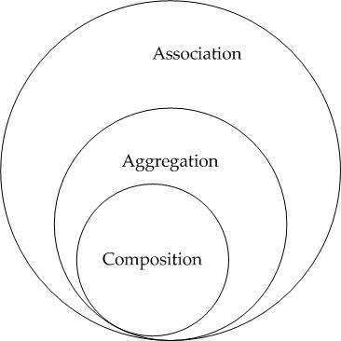
Is it association, Aggregation, or composition?

Slide 19
Generalization
Models “is a special kind of” relationship
Generalization is a relationship between classes, not objects, so multiplicities do not apply
https://www.ibm.com/docs/en/rational-soft-arch/9.7.0?topic=diagrams-generalization-relationships
Example: An employee can be hourly employee or salaried employee
Draw it in Visio

Slide 20
Tips for Developing Class Diagrams
Start small and simple – capture only the key entities
Simple model is easier to understand
It is easier to add to the model that to remove clutter
Expect the diagram to change as you discover more classes or more detail (attributes, operations)

Slide 21
Group Exercise – 30 minutes
Problem description in a separate Word document: Class Diagram Exercise - Hospital
Use common knowledge to add more information
Identify classes (with attributes and possibly operations)
Identify relationships (for associations, indicate name or role names, and multiplicities)
Draw UML class diagram in Visio

Slide 22
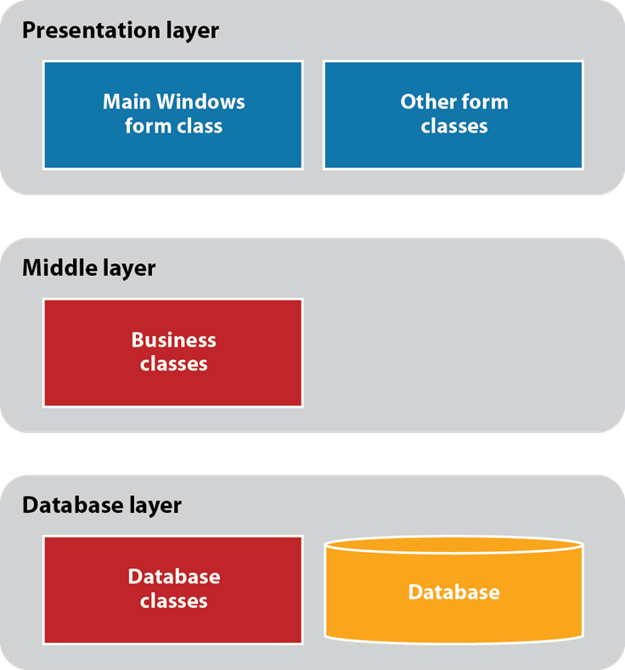
Three-Layer Application Structure

Slide 23
Package
A package is a collection of logically related classes (a sub-system)
Package A depends on package B when package A accesses package B (a method in one of the classes in package A calls a method from a class in package B)
Package A needs to import package B

Slide 24
UML Package Diagram
Used mostly for medium to large systems
A package diagram shows packages and dependency relationships between them
https://www.uml-diagrams.org/package-diagrams-overview.html
https://www.visual-paradigm.com/guide/uml-unified-modeling-language/what-is-package-diagram/

Slide 25
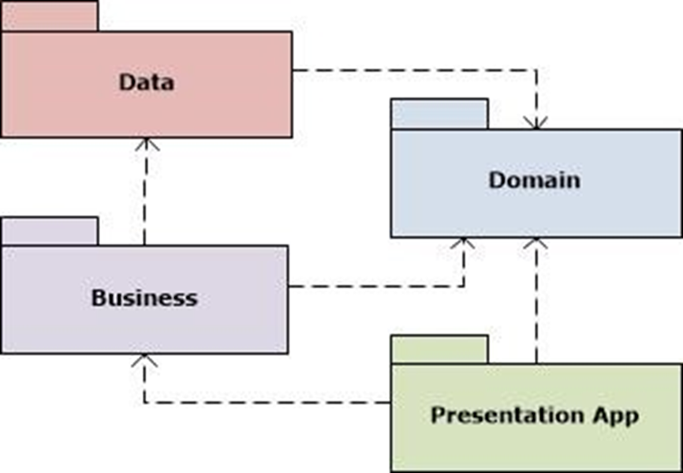
Package diagram example

Slide 26
More types of UML Diagrams
https://www.tutorialspoint.com/uml/index.htm
http://www.agilemodeling.com/essays/umlDiagrams.htm

Slide 27
Project Closing
https://www.projectmanager.com/blog/project-closure

Slide 28
Work on Assignment 4 - Class Diagram

